Slide 1
Task 2: Read the text again and decide whether the following statements are True (T) or False (F).
F
Tom Pilston went to Chicago for holiday.
He couln’t take the photograph of Obama because he forgot his camera.
People were waiting to see Obama on the TV screens.
It wasn’t a cold night.
He took this photo inside the center.
People lost control of their feelings when Obama won the election.
F
F
T
F
T

Slide 2
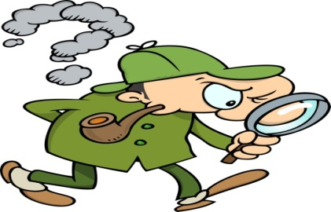
vocabulary
1. Moment (n): very short period of t

